Slide 1

DEPARTMENT OF ELECTRONICS AND COMMUNICATION ENGINEERING ATTENDANCE MONITROING AND FEE NOTIFICATION SYSTEM WITH PARENT ALERT MECHANISM
BATCH NO : 8
BATCH MEMBERS :
NAME REG NO
GOKUL KUMAR .L 231081102603
SANJAY .S 231081101069
SANTHOSH .S 231081101071
PRAKASH .S 231081101057
GUIDE NAME: A. ABILASHA

Slide 2
INTRODUCTION
Bridging the Communication GapIn the digital age, educational institutions require automated solutions to handle administrative tasks efficiently. This project focuses on a "Full-Stack" approach to monitor student regularities and financial commitments.The system acts as a central hub for teachers, administrators, and parents to stay informed in real-time about attendance percentages and pending fee statuses.

Slide 3
Project Objectives:
Automation:To replace the manual attendance register with a digital, real-time tracking interface.
Proactive Alerts: To implement an instant notification system for parents via SMS and Email APIs.
Data Analytics: To provide graphical insights into attendance trends and fee recovery rates.
Data Integrity: To ensure secure storage of student records using modern database encryption.

Slide 4
The Problem Statement:
Manual Errors:
Traditional paper-based attendance is prone to human error and data manipulation by students.
Communication Delay:
Parents are often unaware of their child's absence until the end of the semester or through physical letters.
Fee Collection Delays:
Inefficient tracking of fees leading to financial backlog and manual reminder burdens on staff.

Slide 5
Proposed Solution:
We propose a unified Full-Stack Web Application that automates daily roll-calls and fee tracking.
Automated Attendance Calculation
Smart SMS/Email Alert Triggers
Role-Based Dashboards (Admin/Parent)

Slide 6
Technology Stack:
Modern Web Development
The system is built on the MERN stack for high performance and scalability:
MongoDB: NoSQL database for flexible student records.
Express & Node.js: Scalable backend server logic.
React.js: Dynamic and responsive user interfaces.
Twilio & Nodemailer: Alert mechanisms.

Slide 7
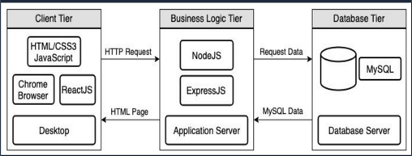
System Architecture:
Layered Flow:
The architecture follows a standard three-tier model to ensure separation of concerns and maintainability.
Presentation Layer: React Components for Admin & User Dashboards.
Logic Layer: Node.js API handling business rules for alerts.
Data Layer: MongoDB storing user profiles and transaction history.

Slide 8
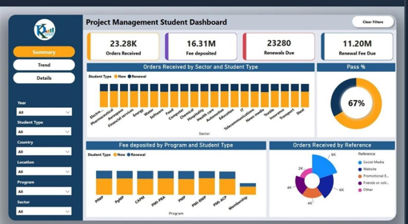
Core System Modules:
Attendance & Fee Tracking
Our system is divided into functional modules for seamless operations.
User Management: Registration of Students and Staff.
Attendance Engine: Daily marking and percentage auto-calculation.
67%
Fee Ledger: Payment history, dues tracking, and receipt generation.
Notification Controller: The logic behind automated parent alerts.

Slide 9
The Alert Logic:
ATTENDANCE THRESHOLD 75 %
Automated Trigger System
The system runs a background script (Cron Job) that monitors daily records. If a student's attendance falls below the specified percentage, an automatic warning is dispatched.
Alert Status = {
Trigger SMS
if Present Days < 0.75 Total Days
Trigger Email
ifFee Balance > 0

Slide 10
Parent Alert Mechanism:
Real-Time TransparencyThe SMS notification ensures that parents are instantly notified when their child is absent, promoting accountability and safety.Fee notifications are sent 5 days prior to the deadline, reducing late payment instances significantly through persistent, friendly reminders.

Slide 11
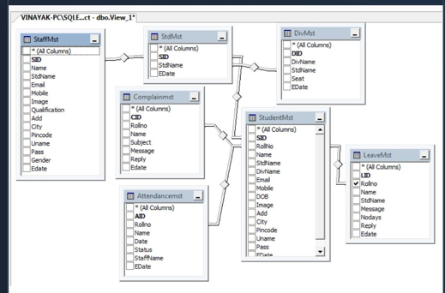
Database Schema:
Relational Data StructureEven in MongoDB, we maintain structured relations via Student IDs:Students: basic info, parent contact, class.Attendance: Date, Status (P/A), StudentRef.Fees: Amount, DueDar, PaidStatus, TransactionID.

Slide 12


